Slide 1
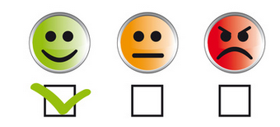
Twitter Sentiment Analysis
Landon Greer
This Photo by Unknown Author is licensed under CC BY-SA-NC

Slide 2
What is Sentiment Analysis?
Sentiment Analysis is the mining of string data to determine whether it is Positive or Negative often used for customer feedback.
Your powerpoint is awesome!- Positive Sentiment
Worst powerpoint ever!!!!- Negative Sentiment
Something I found interesting was that after I originally created this slide, Powerpoint had a few design recommendations, and this was one of them. A perfect example of sentiment analysis being done since the thumbs up and frowny face were recommended by an AI.

Slide 3

So how do we do Sentiment Analysis?
In theory it is very simple:
Obtain a database of content to analyze
Clean it by removing any unnecessary letters and stem each word to their root word. i.e. stemming→ stem
We need an algorithm to characterize the data as positive or negative
We need an F1 score to see how accurately the data was labeled

Slide 4

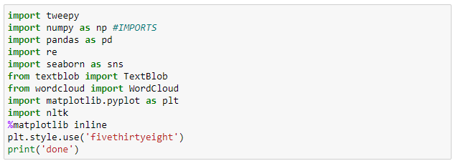
Jupyter
For machine learning it is usually best to work a cellular IDE. For that reason, I decided to use Jupyter.
The difference between a cellular IDE and an ordinary one is that we can run segments of the code instead of the whole thing.
Imports
After Jupyter is installed, its time to import our libraries. You may have to install these using the anaconda prompt
Here is the imports, I will explain what each one does when we use them
This Photo by Unknown Author is licensed under CC BY-SA

Slide 5
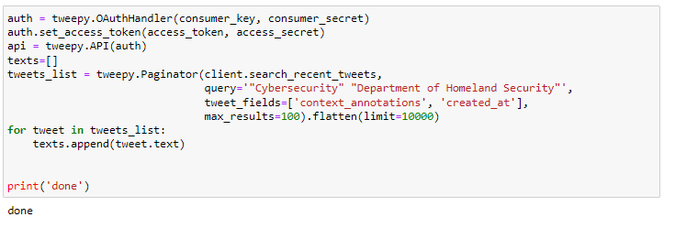

Obtaining tweets
We first must obtain access to Twitter API at Twitter’s Developer Portal
After you obtain developer access on Twitter, you will be granted keys that allow you to access the API: Consumer Key, Consumer Secret Key, Access Token, Secret Access Token, and the Bearer Token. I highly recommend keeping these hidden.
Here we create a list of tweets and texts regarding Cybersecurity and the Department of Homeland Security
In our case here, we are obtaining 10000 tweets, but this will be trimmed down later in the process
The library tweepy allows us to access the API in python
This Photo by Unknown Author is licensed under CC BY-SA

Slide 6

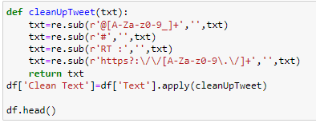
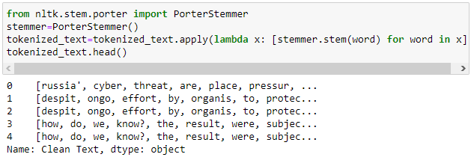
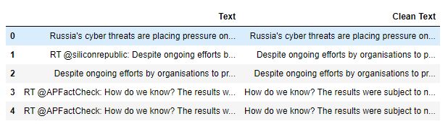
Tokenization and Stemming
Using the pandas library, we turn our list of tweets into a database
After we have our database, we use the library re to clean and remove any unnecessary characters
Once we have our clean text, we add it to the database separately from the original text
After the text is cleaned properly, its time to stem, for this I used the library nltk
As you can see in the picture below, the text has now been simplified to its simplest root form.

Slide 7
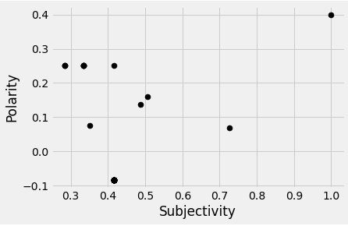
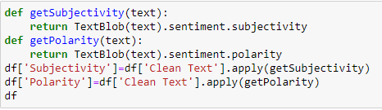
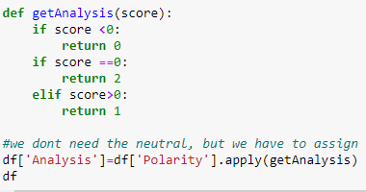

Now that we’ve come this far, its time to get to the actual meat of the project, characterizing the data.
Before we can assign the text as positive or negative, we must first assign it values based on how subjective and how polar the text is:
We are using the library TextBlob to do this
Using the polarity, we can then assign a score; The number zero represents a negative tweet, the number one represents a positive tweet, and two is neutral.
We do not need the neutral tweets, so we discard them
After the neutral tweets are removed, the database is finished and is ready to be written to a csv file

Slide 8
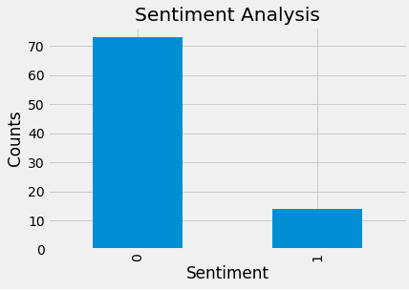
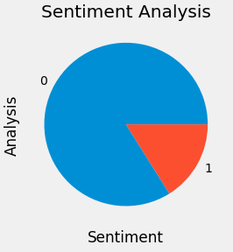
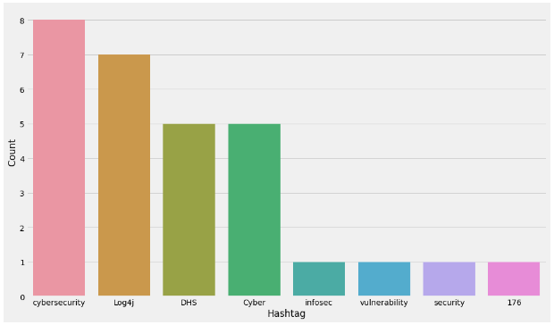
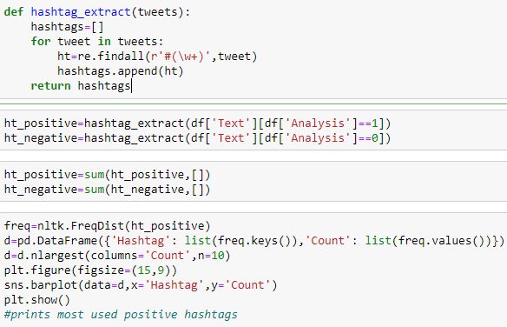
Now that the database is finished, we can start creating statistics based on it.
Using matplotlib we can create visual graphs to represent the data we collected.
To reiterate, 0 is negative sentiment and 1 is positive
The majority of tweets this time are negative with a ratio of 70:1, but this isn’t entirely accurate.
By printing out all the hashtags used, its easy to notice an oddity.
There are no negative hashtags compared to the number of negative tweets. This indicates that there were a few extremely popular negative tweets that were retweeted a lot.
There are no negative hashtags to print

Slide 9

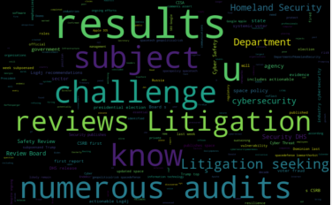
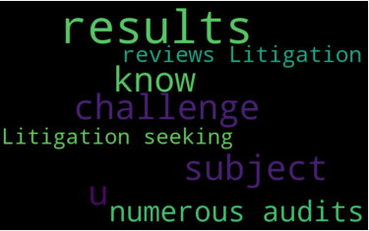
Most used words
Using the library wordCloud, we can see which words were used most. The picture below represents this
The photo on the right represents all of the positive words used, and the photo on the bottom represents the negative tweets
The lack of negative words further proves that there was one tweet with hundreds of retweets
Tweet in question

Slide 10
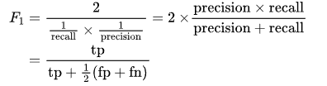
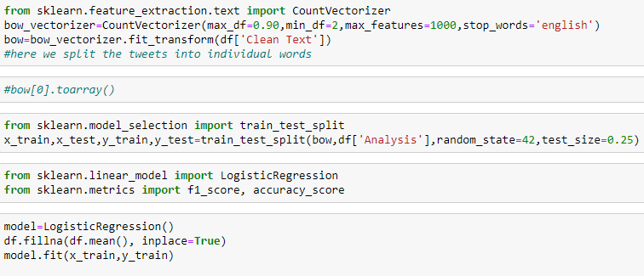
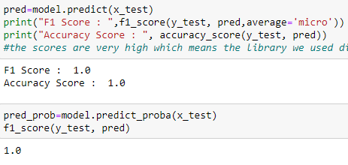
The only thing left to do is get our f1 score
So what’s the point of an F1 Score?
Well, the F1 Score will make predictions on the dataset and compare it to the the predictions made earlier. It does this by combining the precision and recall.
Precision is the number of true positive divided by the total of positive predictions (true positives plus false positives)
Recall is the number of true positives divided by the total number of actual positives (true positives plus false negatives)
Image obtained from DeepAI
The F1 scores have been averaging very high (about 9.7) but this time we got a perfect score of 1

Slide 11

The End
You can access the code here and the csv file here

